Slide 1


THE THEORY OF ECOLOGICAL COMMUNITIES
Chascomús, Argentina November 2019

Slide 2

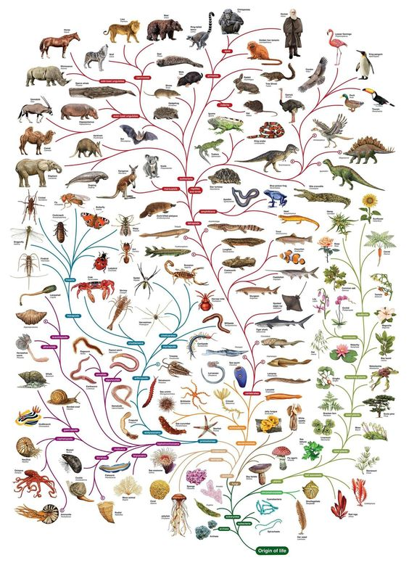
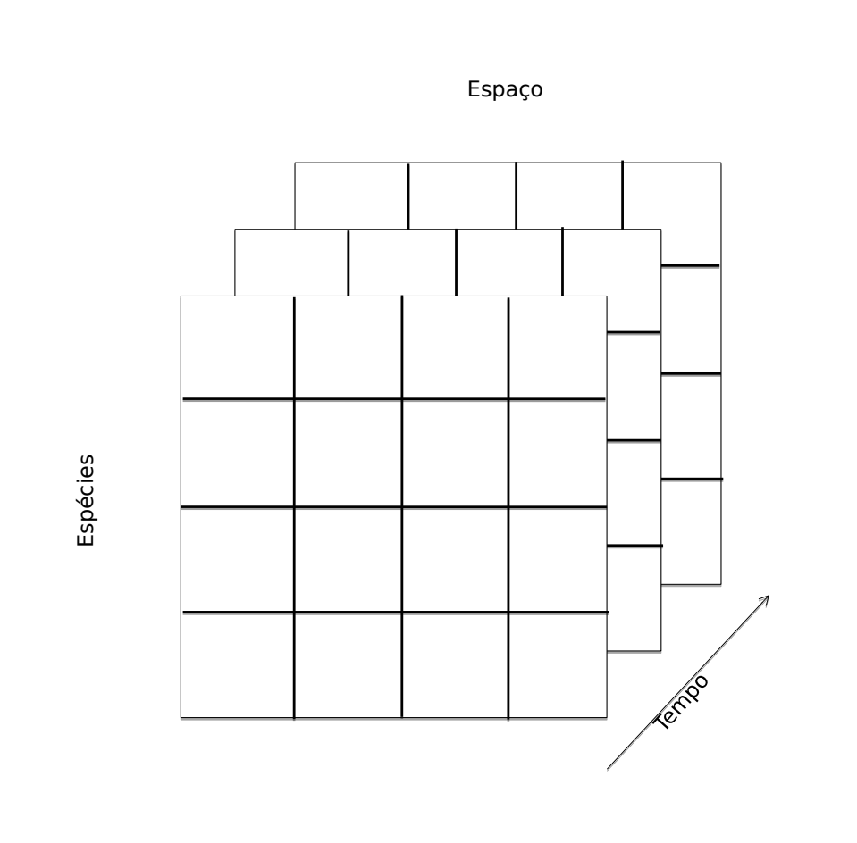
What is Community Ecology?

Slide 3
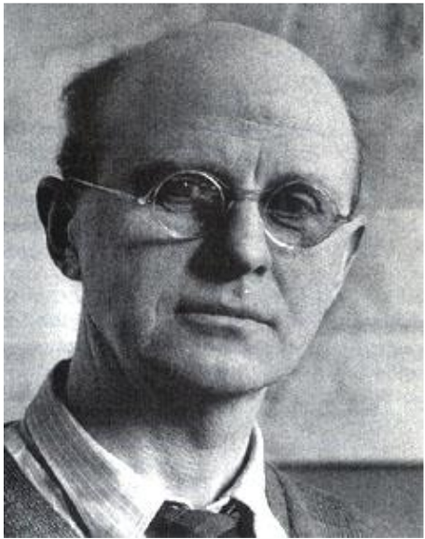
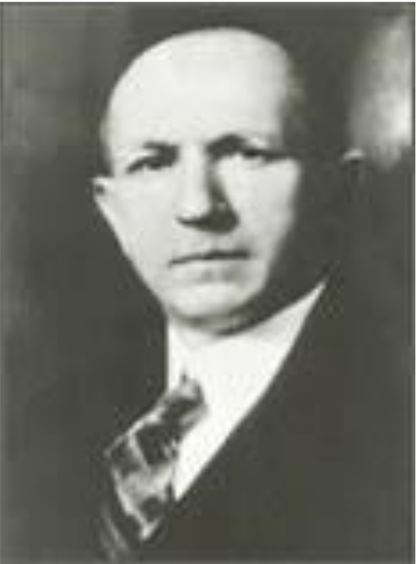
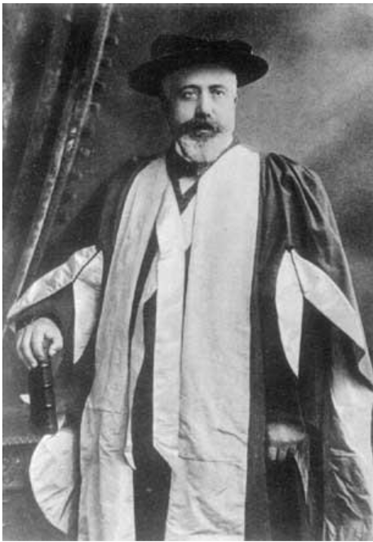
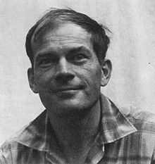



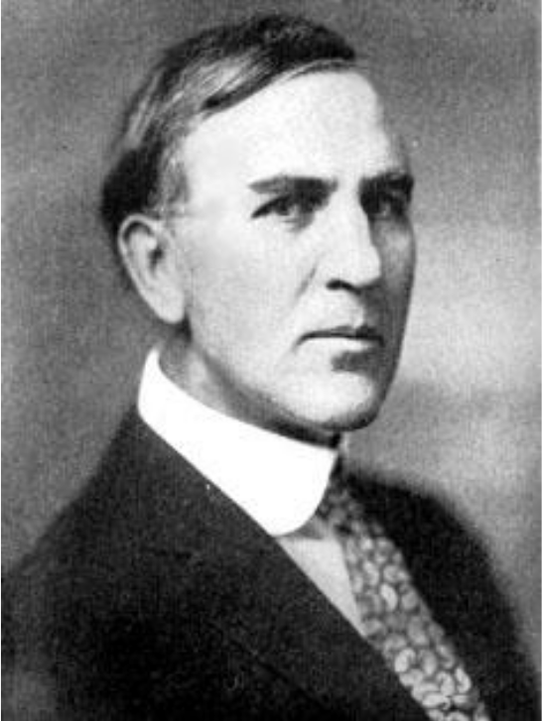
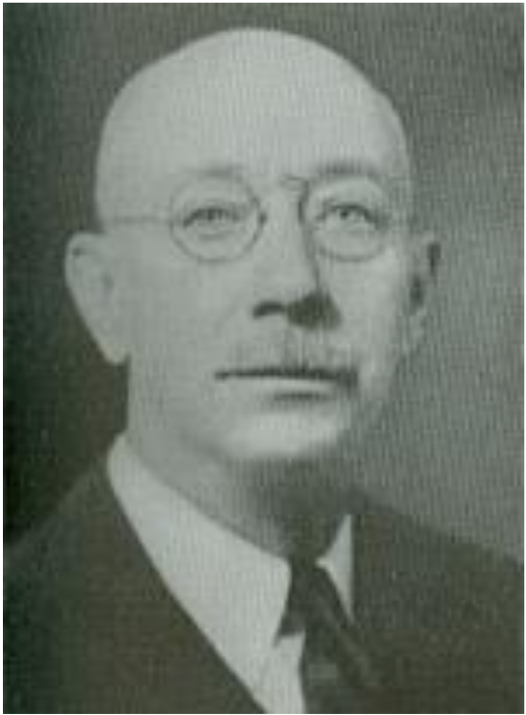
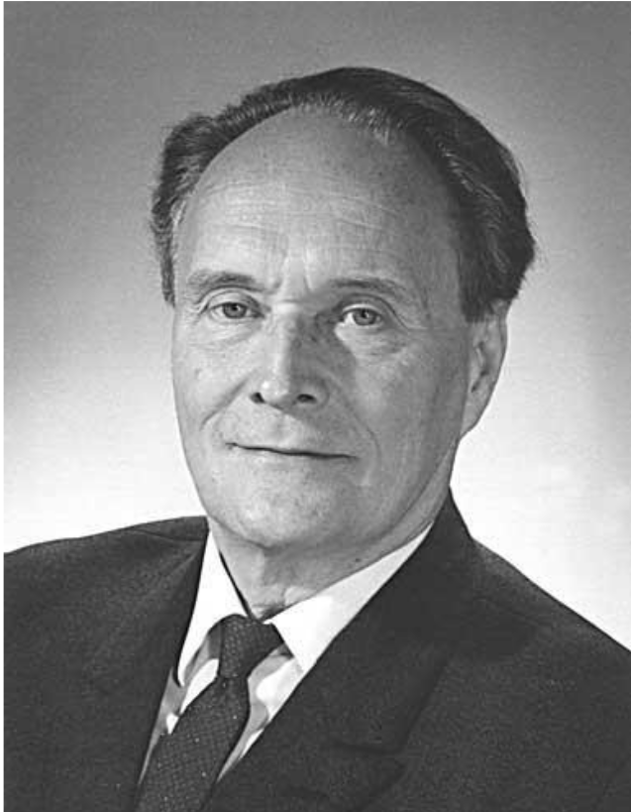
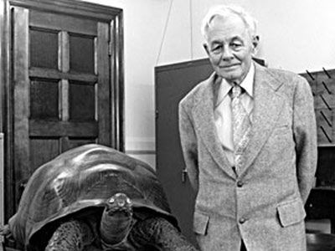



One hundred years of hundreds of ideas in Community Ecology
Food web / Niche
Gleason (1927)
Competitive model
Lotka-Volterra (1926)
Island Biogeography
MacArthur & Wilson (1967)
Regional Species Pool
Ricklefs (1987)
Metacommunities
Leibold (2004)
Species response to gradients
Gleason (1926)
Competitive exclusion
Gause (1934)
N dimensional Niche
Hutchinson (1957)
Resource-based Competition
Tilman (1982)
Null models
Ricklefs & Graves
(1996)
Closed communties
Clements (1917)
Neutral Theory Hubbell (2001)
1910 1920 1930 1940 1950 1960 1970 1980 1990 2000 2010

Slide 4

What a mess...
Food web / Niche
Gleason (1927)
Competitive model
Lotka-Volterra (1926)
Island Biogeography
MacArthur & Wilson (1967)
Regional Species Pool
Ricklefs (1987)
Metacommunities
Leibold (2004)
Species response to gradients
Gleason (1926)
Competitive exclusion
Gause (1934)
N dimensional Niche
Hutchinson (1957)
Resource-based Competition
Tilman (1982)
Null models
Ricklefs & Graves
(1996)
Closed communties
Clements (1917)
Neutral Theory Hubbell (2001)
1910 1920 1930 1940 1950 1960 1970 1980 1990 2000 2010

Slide 5

One hundred years of hundreds of ideas in Community Ecology
Food web / Niche
Gleason (1927)
Conceptual Synthesis
Vellend (2010)
Competitive model
Lotka-Volterra (1926)
Island Biogeography
MacArthur & Wilson (1967)
Regional Species Pool
Ricklefs (1987)
Metacommunities
Leibold (2004)
Species response to gradients
Gleason (1926)
Competitive exclusion
Gause (1934)
N dimensional Niche
Hutchinson (1957)
Resource-based Competition
Tilman (1982)
Null models
Ricklefs & Graves
(1996)
Closed communties
Clements (1917)
Neutral Theory Hubbell (2001)
1910 1920 1930 1940 1950 1960 1970 1980 1990 2000 2010

Slide 6

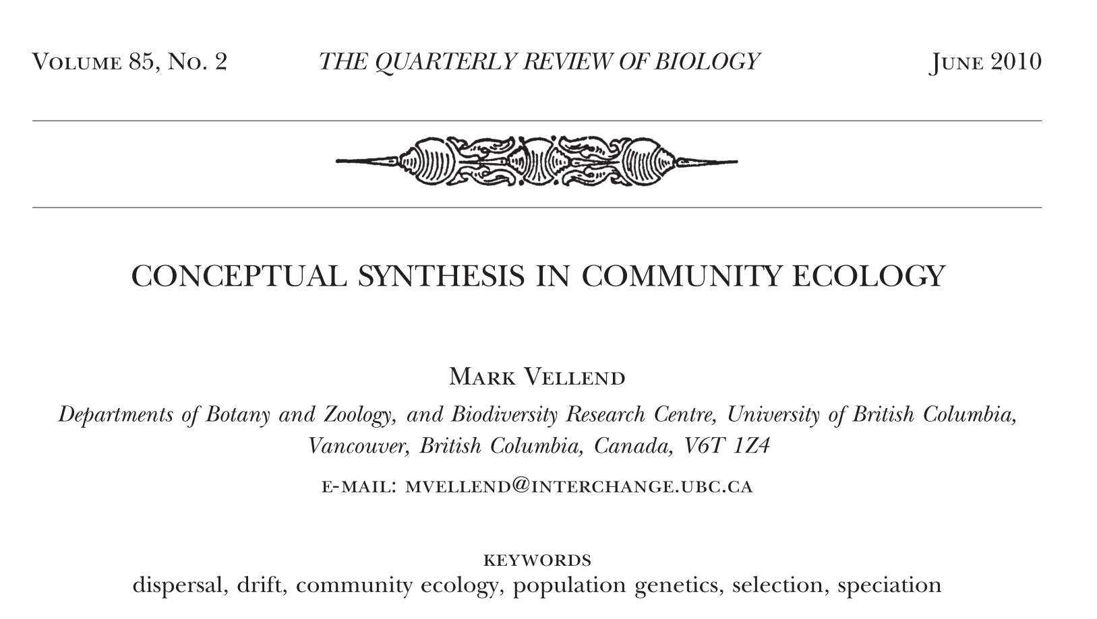
The hunt for a conceptual synthesis
6 years later
Vellend 2010
Vellend 2016

Slide 7
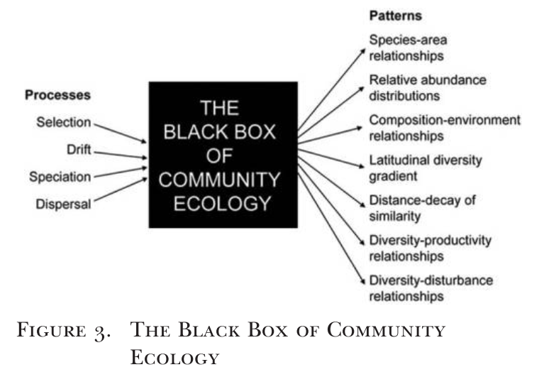
High-level ecological processes
Vellend 2010

Slide 8

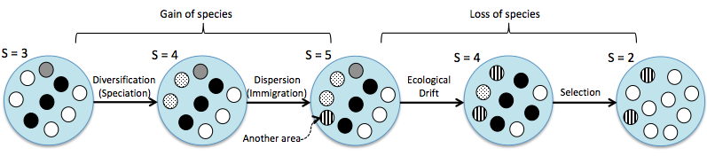
Adapted from Vellend 2010 2016

Slide 9
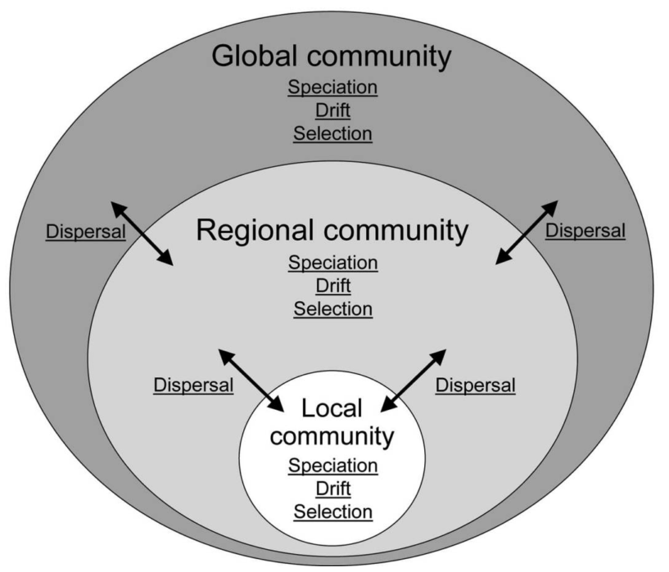
Adapted from Vellend 2010 2016

Slide 10
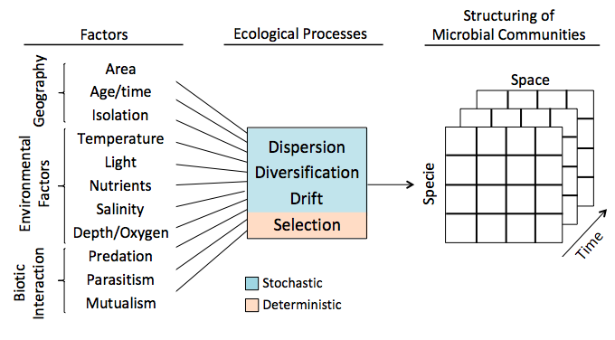
Adapted from Vellend 2016

Slide 11
Selection | Dispersal | Drift | Speciation | Theory | Reference
X |  |  |  | Niche | Elton (1927); Hutchinson (1957)
 | X |  | X | Island Biogeography | MacArthur & Wilson (1967)
 | X | X | X | Neutral | Hubbell (2001)
X | X |  | X | Metacommunities | Leibold et al (2004)
X | X | X | X | Ecological Synthesis | Vellend (2010)
Adapted from Vellend 2010

Slide 12
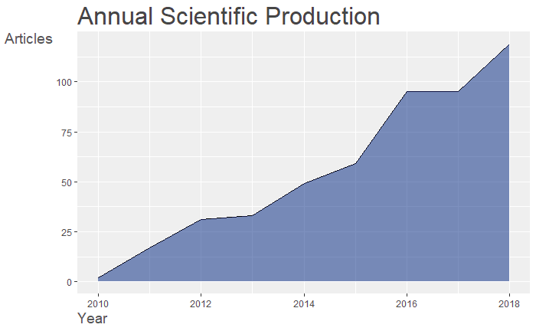
Brief scientometrics
Average citation per year: 49.67

Slide 13
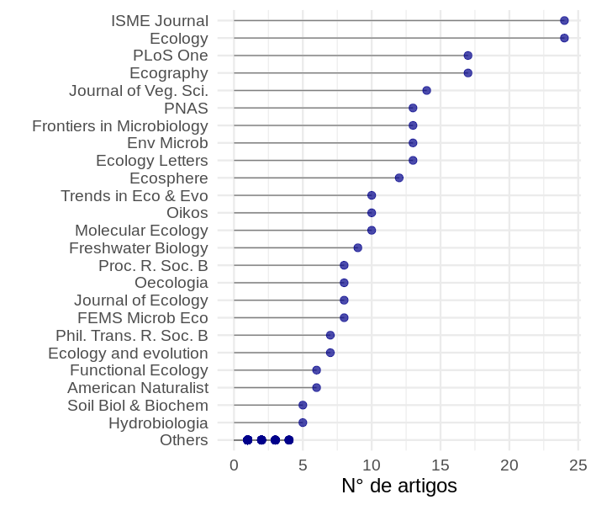
Papers of impact
Number of citations per journal

Slide 14
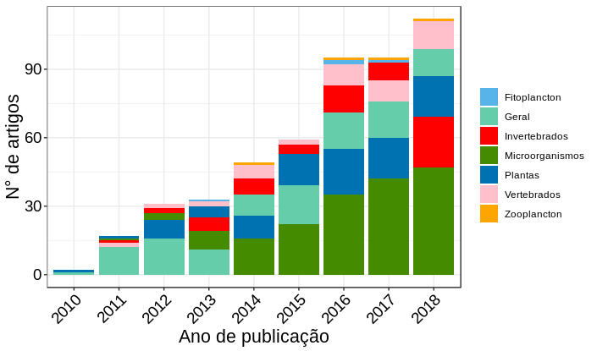
Microbes rule...
Sampling size: 500 papers

Slide 15
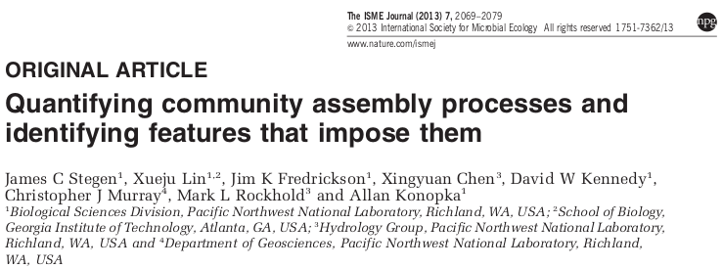
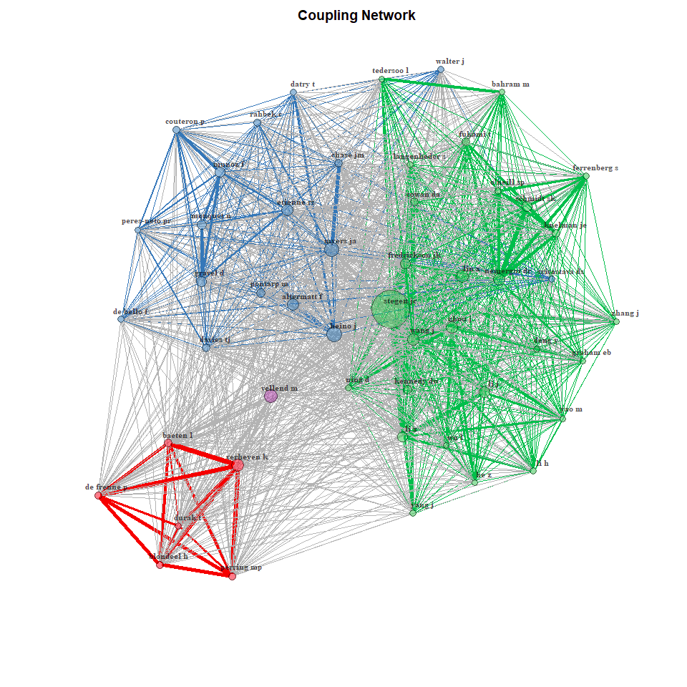
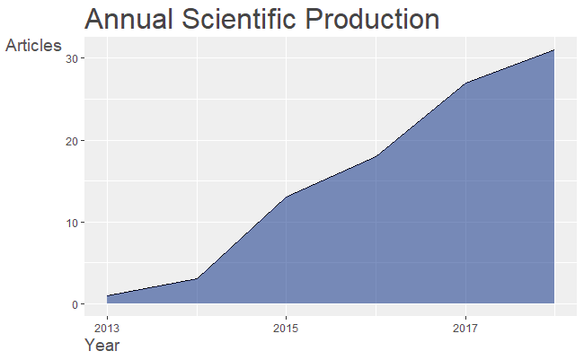
Why?
Stegen et al. 2013 = 221 citations

Slide 16
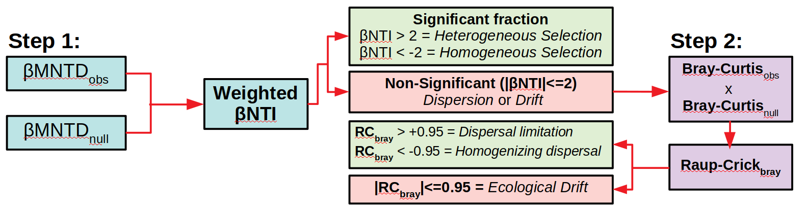
Why?
Stegen et al. 2013 = 221 citations

Slide 17
Which ones are applied?
How many have tried to quantify the processes? Until December 2018 =
6
Aquatic sediments
Underground water
Lakes
Ocean microbiome
Human Gut Microbiome
Fish Gut Microbiome
Shrimp Gut Microbiome
Interesting for comparisons between ecosystems and organisms

Slide 18
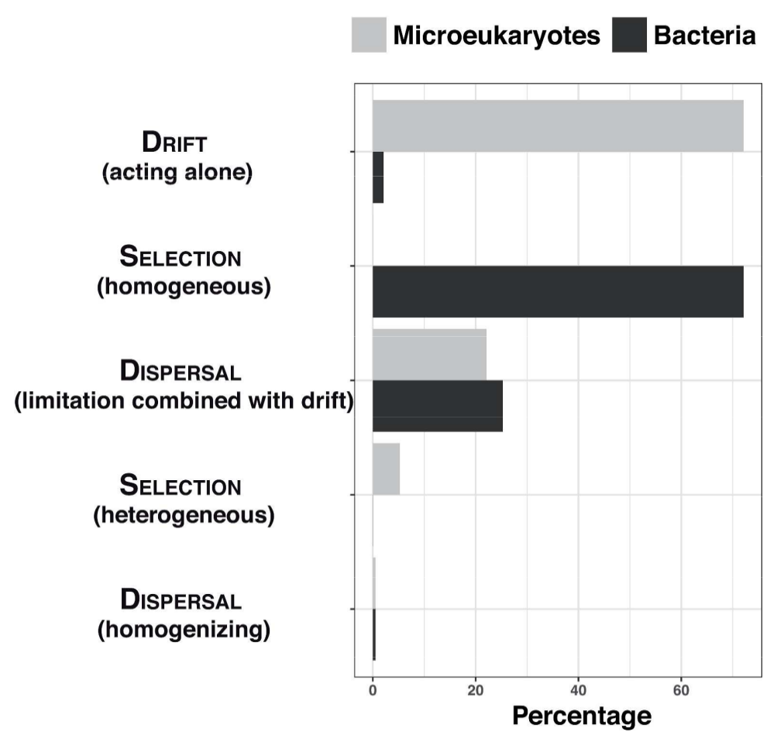
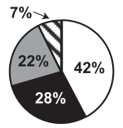
Examples
Stegen et al. 2013
Logares et al. 2018

Slide 19
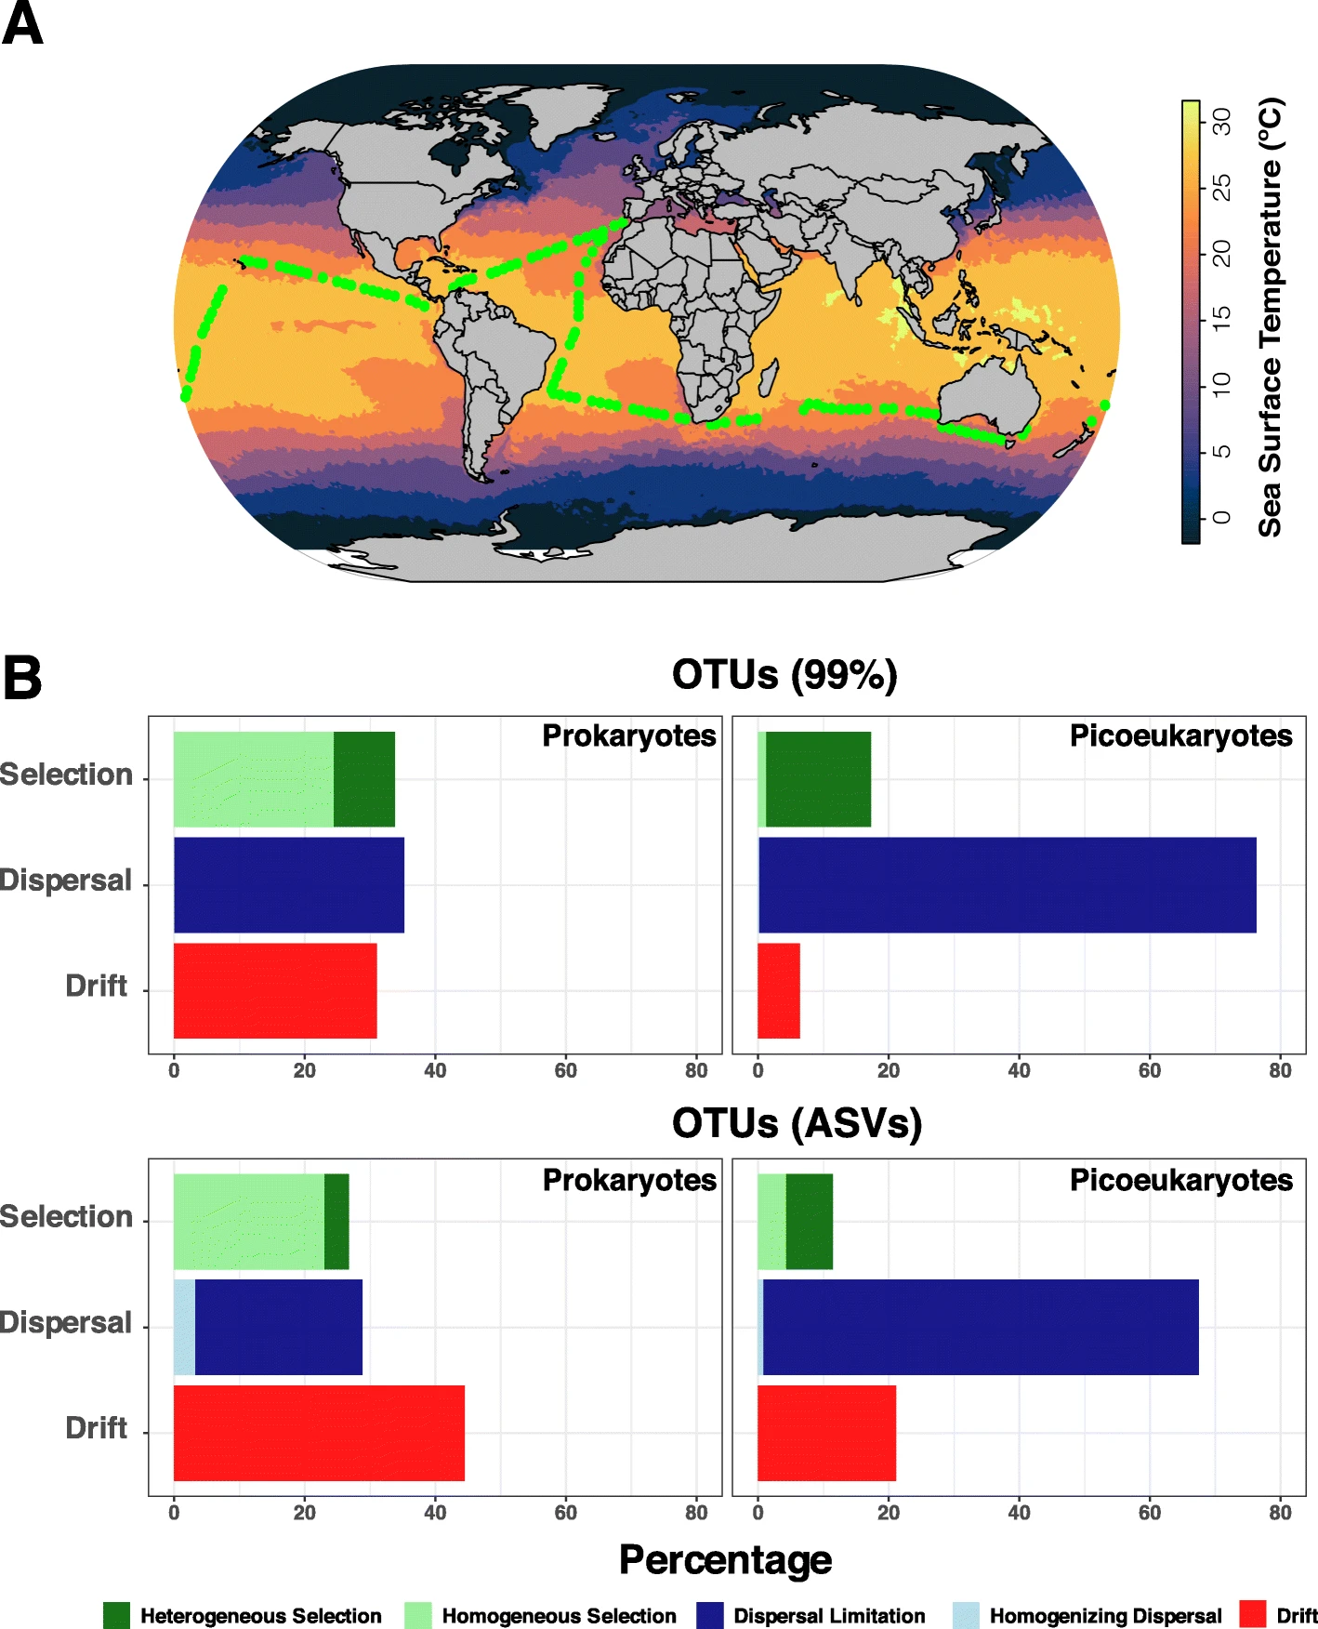
Examples
Logares et al. 2020

Slide 20
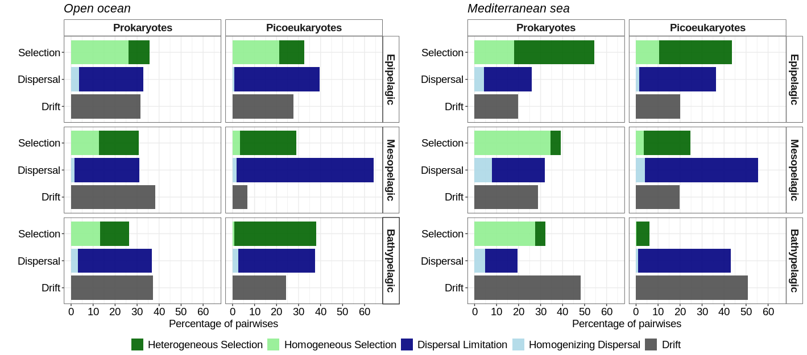
Examples
Junger et al. In prep

Slide 21
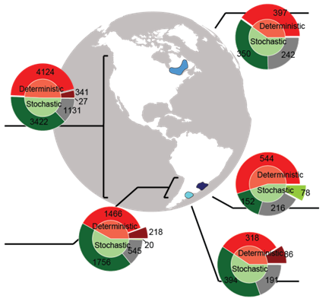
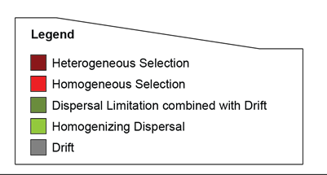
Examples
Mateus-Barros et al. In prep

Slide 22
Obrigado! Gracias!

